Slide 1
03 | Web Workers

Slide 2
Module Overview
XML HTTP Request
Ajax
Web Sockets
SignalR

Slide 3
XML HTTP Request

Slide 4
Calling the server
One of the main goals of modern web applications is to mimic locally installed applications
The catch? A lot of the data and resources you need are on the server

Slide 5
Enter XML HTTP Request object
Originally created to support Outlook Web Access
Later added to Mozilla and became a de facto standard
Allows for "raw" calls to the server

Slide 6
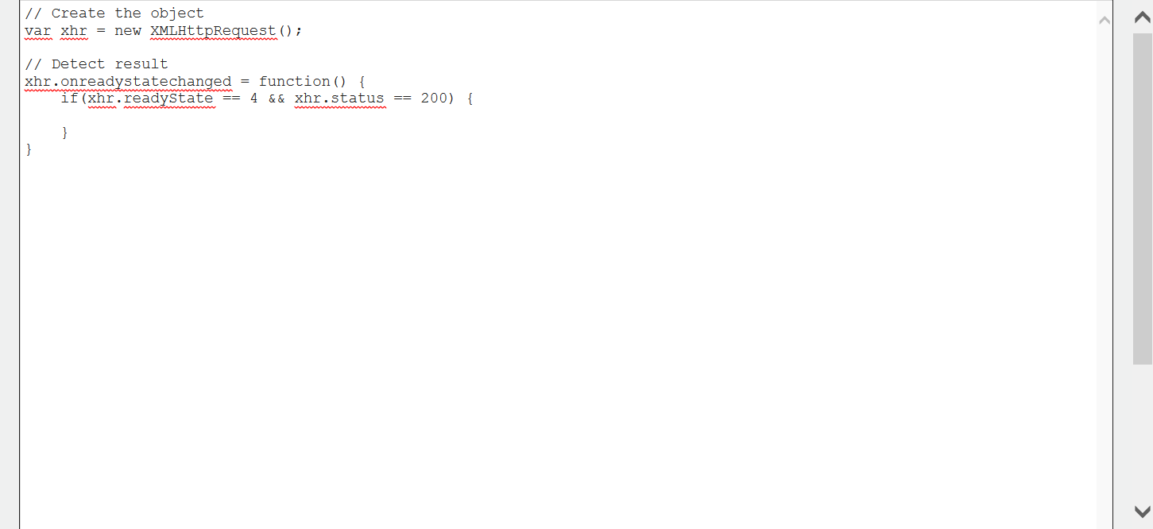
Sample call

Slide 7
Web workers

Slide 8
Some notes and design thoughts
Web workers can pass any JSON object
Workers don't have events for start or end
Can easily be implemented through basic messaging
Stopping a web worker
From page
worker.terminate();
From worker
self.close();

Slide 9
Web worker design

Slide 10
jQuery Promises

Slide 11
Asynchronous programming
Certain operations can take an unknown amount of time
Making server calls
Working with graphics
Certain operations perform at unknown times
Timed events
Web sockets
Asynchronous programming allows us to manage those situations

Slide 12
jQuery Promise object
jQuery Promise is an implementation of the promise pattern
Put simply, the promise pattern allows a developer to register event handlers for various events or states
Failed
Succeeded
In progress

Slide 13
Three common Promise events
done
Operation has completed successfully
fail
Operation has completed unsuccessfully
progress
Operation has reported a progress update

Slide 14
jQuery Promises

Slide 15
jQuery Deferred

Slide 16
Long running operations
You can create your own long running operations and allow other developers to register event handlers
Deferred object is used to manage long running operations and raise events on completion, failure, etc.

Slide 17
Long running operation pattern
Create a deferred object
var deferred = $.Deferred();
Start your async operation
Return a promise
return deferred.promise();
Call resolve for success
deferred.resolve();
Call reject for failure
deferred.reject();

Slide 18
Using the deferred object

